Slide 1
FLOODED AREA DETECTOR
Group Members:
Siddi Sujith (15241A05T1)
Nallana Harish (16245A0546) Internal Guide:
Shashi Preetham G (15241A05P9) Dr. Ch. Mallikarjuna Rao
Naveen Naik (16245A0552) (Professor of CSE department)

Slide 2
Abstract:
The abstract of flooded area detection mainly focuses on the classification of images of floods to those of non-flooded images. This can be done using convolutional neural networks which is a feed-forward artificial neural network. This uses supervised learning with back-propagation as its technique. When the images of both the flooded and non-flooded such as roads, different types of terrains are given to the model, it transforms the images into matrices of pixels and

Slide 3
the computation is done on those pixels. By this, accuracy can be achieved because of the coverage of all the pixels from the images and thus successfully classify the images. This model can be helpful when an organization can send a drone for surveillance and the captured images can then be classified in real-time and thus be notified of the floods and appropriate action can be taken without any time delay.

Slide 4
Implementation of project:
The project of image classification is implemented using convolutional neural networks which is a feed-forward network with supervised learning technique.
The convolution process uses cross-correlation as its mathematical operation.
A feature map is obtained in the convolution process and using the feature map, the network is trained.

Slide 5
After training the model, it is tested for accuracy and loss against the validation data collected.
During the training, the neural network model is fitted on the training data collected and pre-processed.
A graph is plotted to visualize the accuracy as well as the loss of trained and validated data.

Slide 6
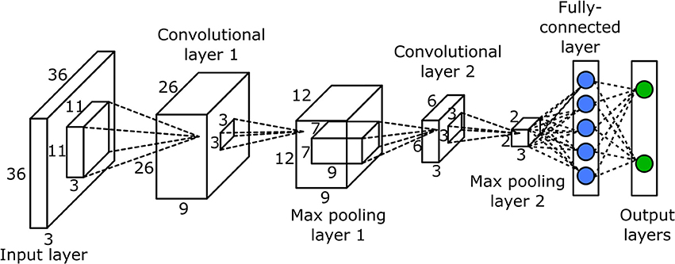
Convolutional neural network Architecture:

Slide 7
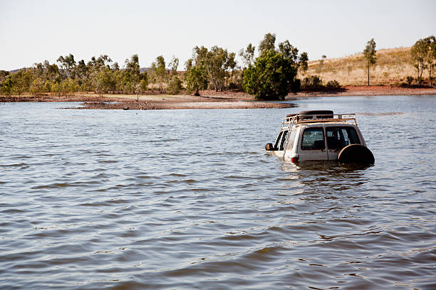
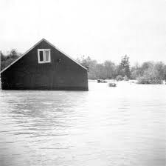
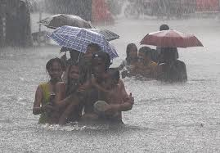
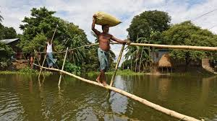
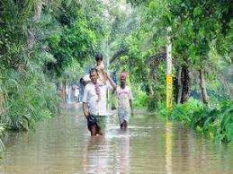
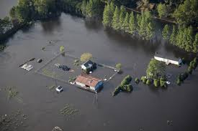
Training Data (flooded):

Slide 8
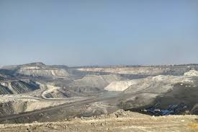
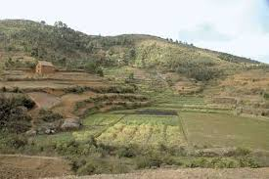
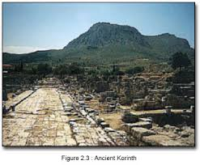
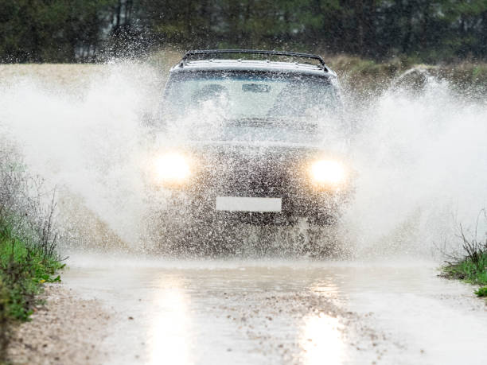
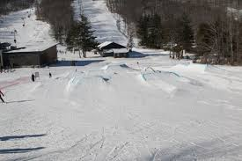
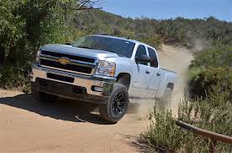
Training Data (non-flooded):

Slide 9
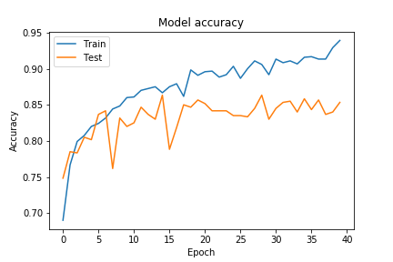
Accuracy of the model (graph):

Slide 10
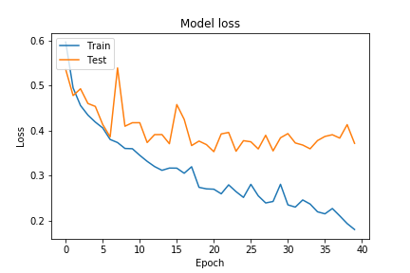
Loss of the model (graph):

Slide 11
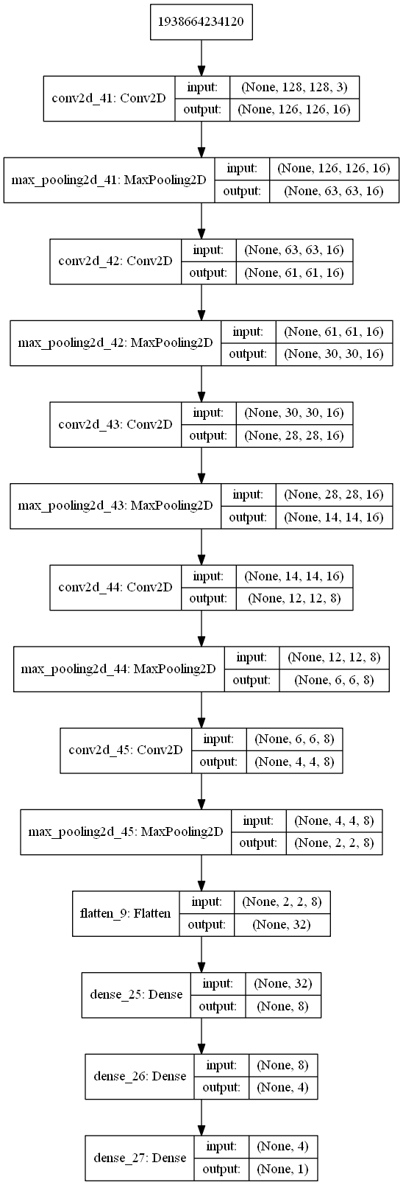
Neural Network model (representation):

Slide 12
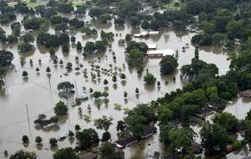
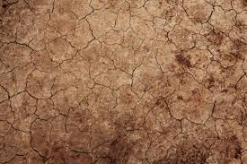
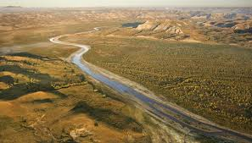
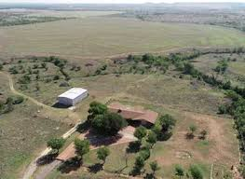
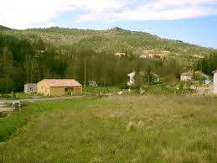
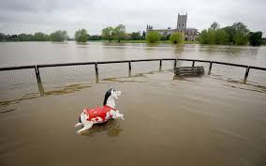
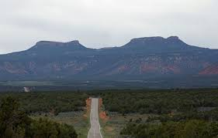
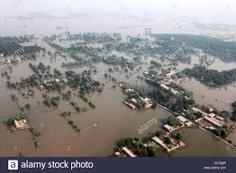
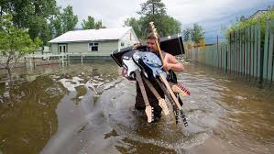
Predictions on sample data:
1.
4.
7.
2.
5.
8.
3.
6.
9.

Slide 13
Results on the prediction samples:
Image Number: | Prediction:
1. | Flooded
2. | Non-flooded
3. | Flooded
4. | Non-flooded
5. | Non-flooded
6. | flooded
7. | Non-flooded
8. | flooded
9. | flooded

Slide 14
Libraries and Packages used in the project:
Keras - Keras is a high-level neural networks API, written in Python and capable of running on top of TensorFlow.
Pandas – It is an open source package which provides data structures and data analysis tools.
Tensorflow – TensorFlow is a package that bundles together a set of machine learning and deep learning models. It uses Python to provide a front-end API for building applications with the framework.

Slide 15
Pillow - Python Imaging Library (abbreviated as PIL) (in newer versions known as Pillow) is a free library for the Python programming language that adds support for opening, manipulating, and saving many different image file formats.

Slide 16
Thank You

Slide 17
Questions ?

